Slide 1
GIT
Lambojon, Paolo T.
7/14/2016

Slide 2


GIT Overview
What is GIT?
Version control system ( Revision Control System)
Repository of files with monitored access
Change made to the source is tracked, with details of:
Who made the change (Author)
Why they made it (Message)
References to problems fixed
Enhancements introduced
Types of VCS:
Distributed Version Control
Centralized Version Control
GIT is a distributed version control system that records changes to a file or set of files over time so that you can recall specific versions later.

Slide 3
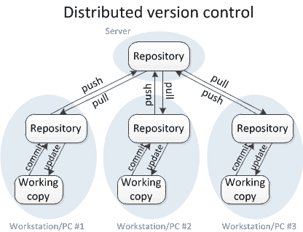
GIT Workflow
Distributed Version Control Diagram

Slide 4
GIT Basics
Snapshots, Not Differences
Nearly Every Operation Is Local
Git Has Integrity
Git Generally Only Adds Data
The Three States

Slide 5
Snapshot-Based Version Control System
How Git references the versions?
Check-ins over time
Version 1
Version 2
Version 3
Version 4
Version 5
A
A1
A1
A2
A2
B
B
B
B1
B2
C
C1
C2
C2
C3
Notes:
browse the history of the project
see the changes introduced between the current version of a file and the file (e.g. a month ago)
you can commit happily until you get to a network connection to upload

Slide 6
Sections of GIT Project
Where the changes are?
Working Directory
Staging Area
Local Repository
Remote Repository
Add
Commit
Push
Pull
Checkout
Fetch

Slide 7



git push
e46817055139d0b41c67fb87ea4f1a5fb83fe076
e46817055139d0b41c67fb87ea4f1a5fb83fe076
e46817055139d0b41c67fb87ea4f1a5fb83fe076
e46817055139d0b41c67fb87ea4f1a5fb83fe076
git clone <gitURL>
git add
git commit –m “commit message”

Slide 8
GIT Goals and Benefits
Speed
Simple design
Strong support for non-linear development (thousands of parallel branches)
Fully distributed
Able to handle large projects like the Linux kernel efficiently
(speed and data size)
Controlled Branching
Better Synchronization

Slide 9
GIT Limitations
Usage Complexity
Repository Permissions
Unmodifiable History
Locks
Updating Very Large Repositories
No Revision Numbers

Slide 10
Three States
Committed, Modified, and Staged
Committed means that the data is safely stored in your local database.
Modified means that you have changed the file but have not committed it to your database yet.
Staged means that you have marked a modified file in its current version to go into your next commit snapshot.

Slide 11
Accenture Bitbucket
Git Hosted Repository

Slide 12
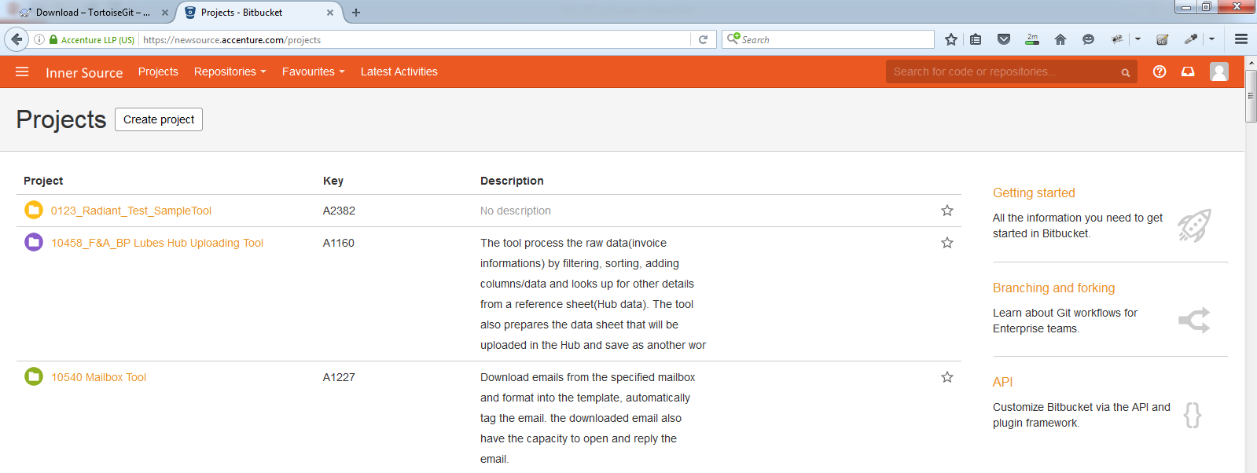

Slide 13
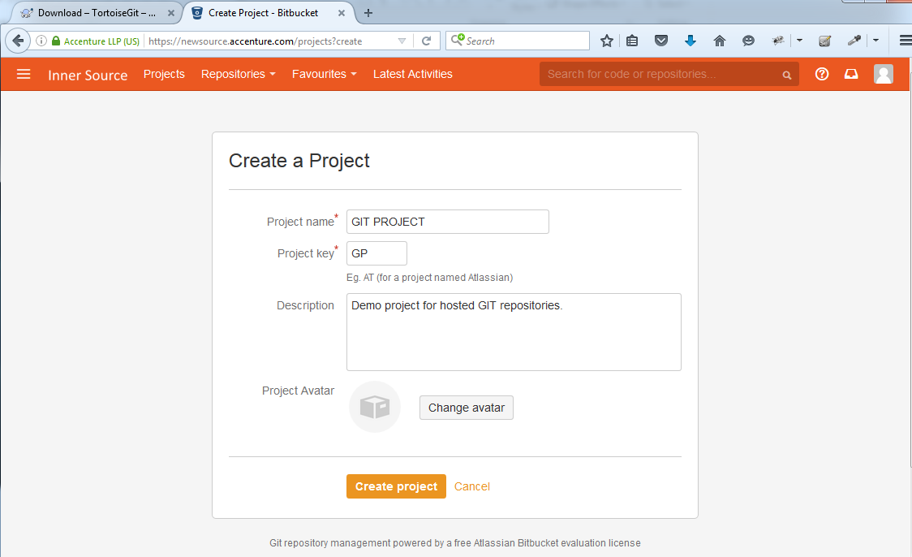

Slide 14
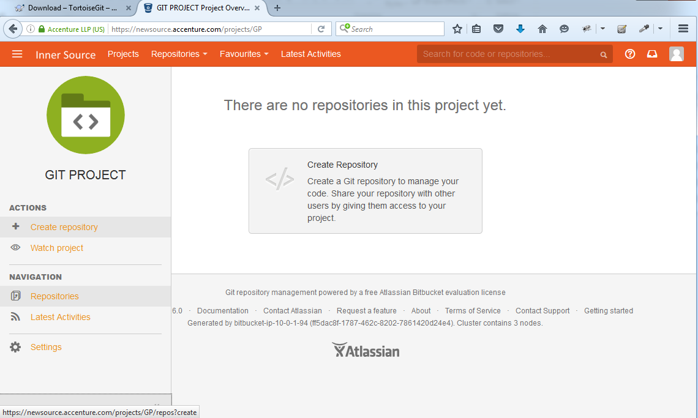

Slide 15
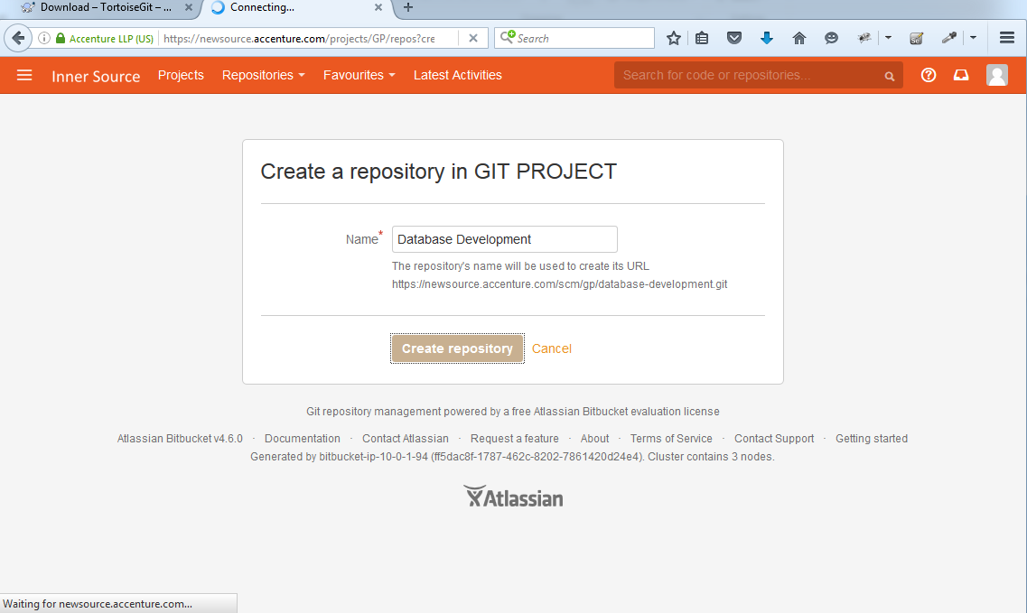

Slide 16
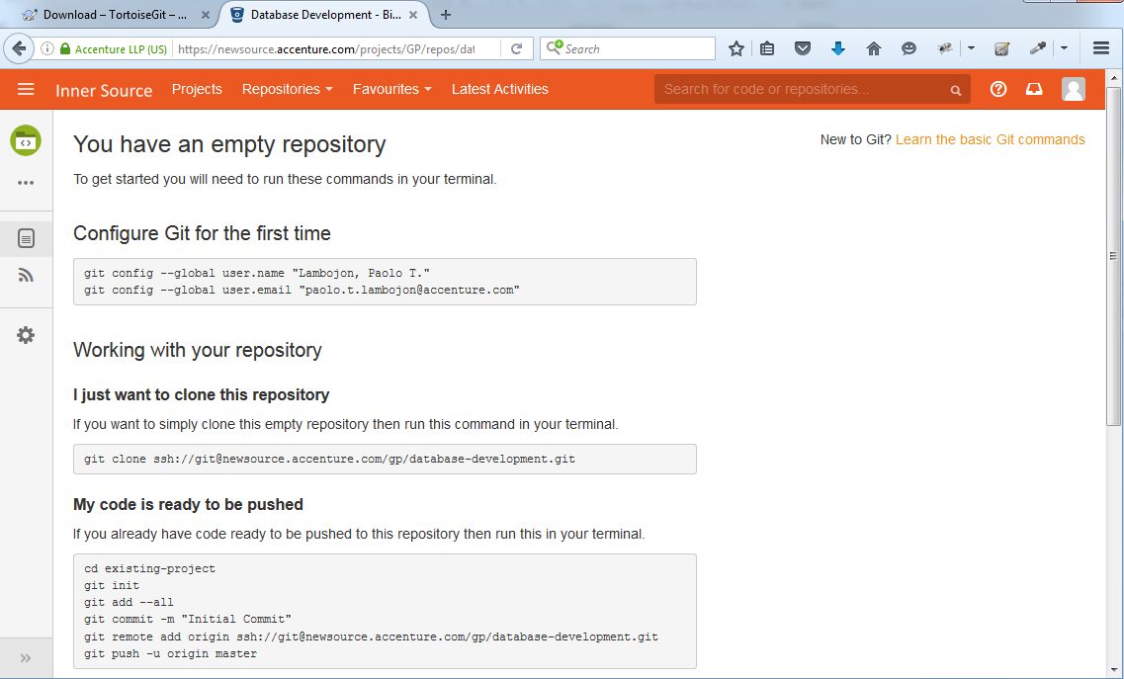

Slide 17
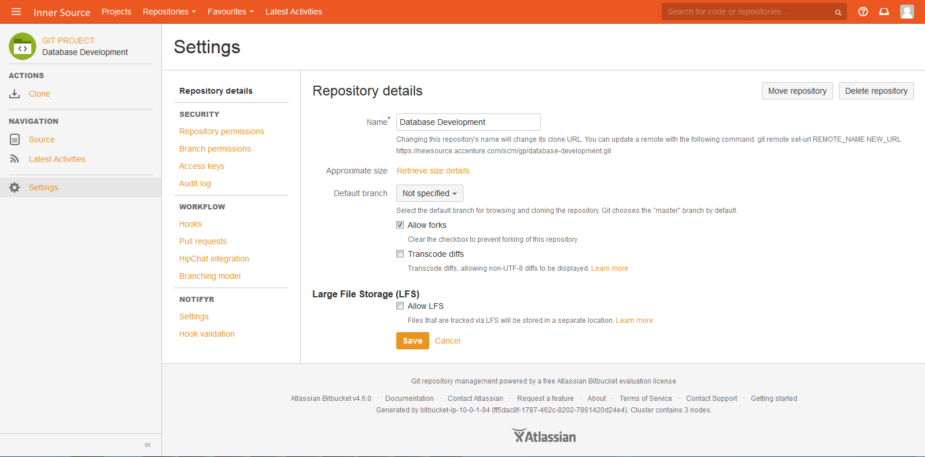

Slide 18
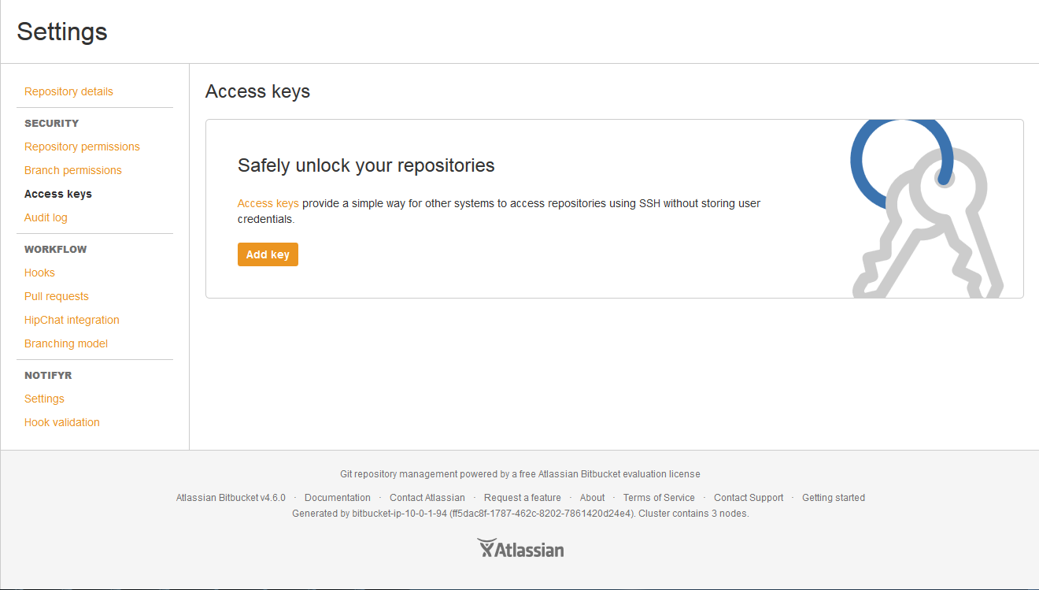

Slide 19
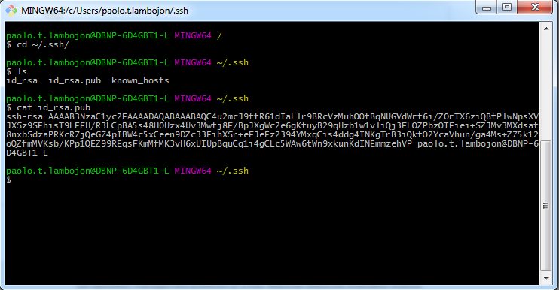

Slide 20
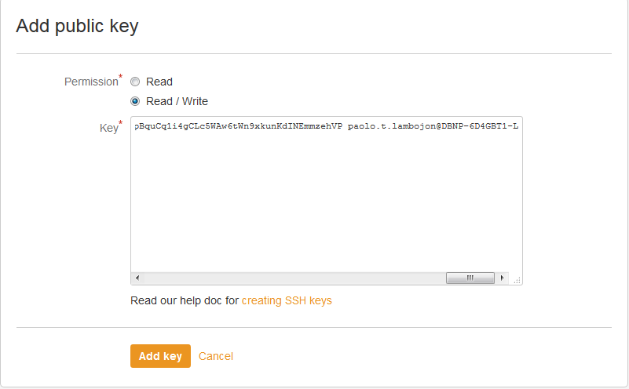

Slide 21
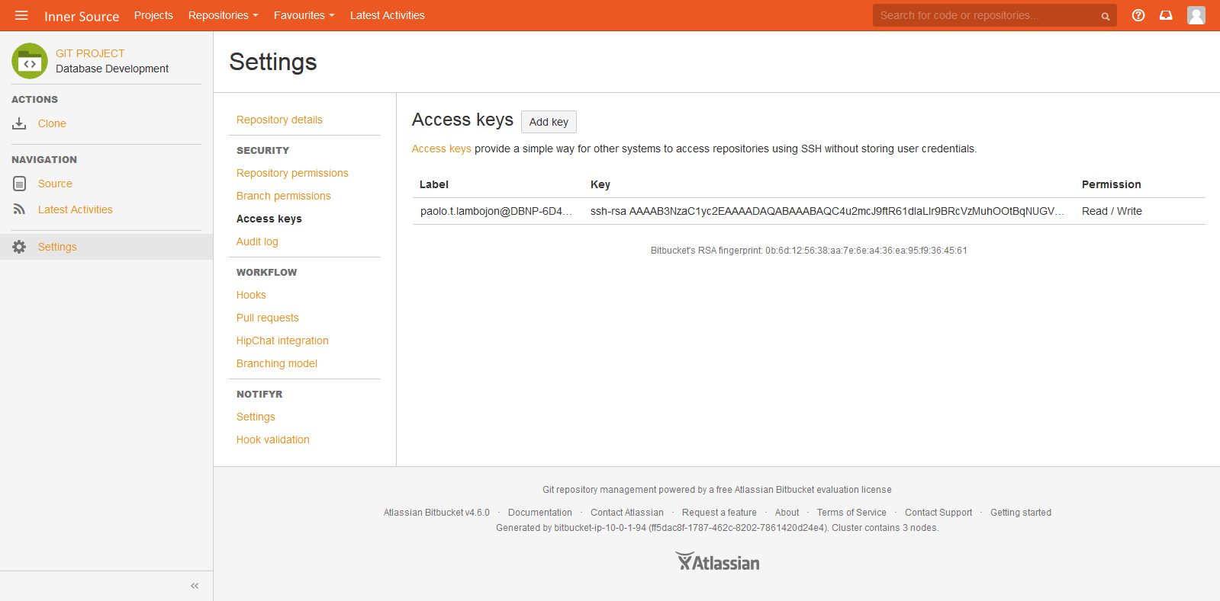

Slide 22
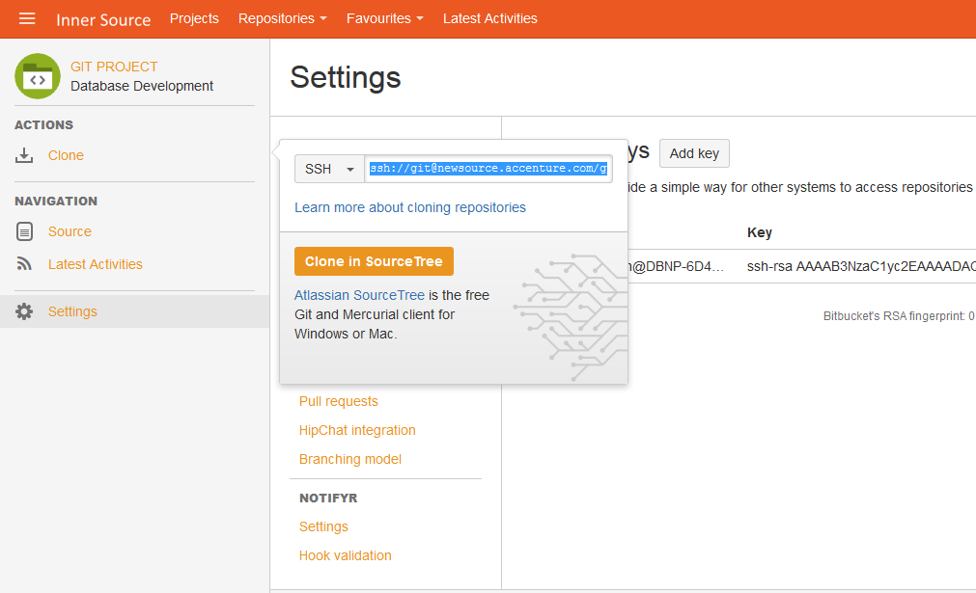

Slide 23
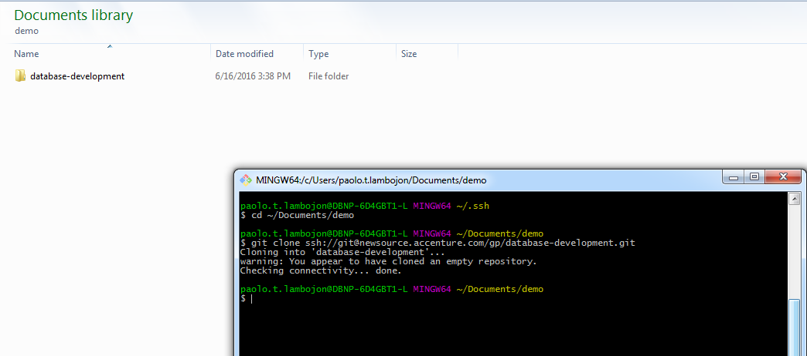

Slide 24
Amazon Web Services
GIT Repository in Cloud

Slide 25
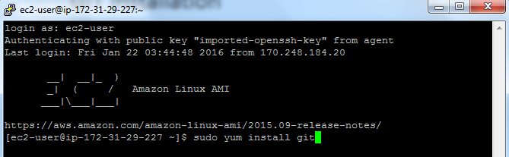
GIT Installation - Remote

Slide 26


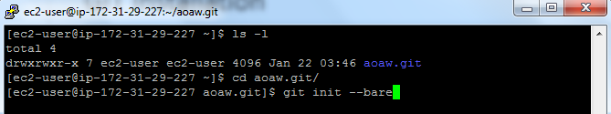
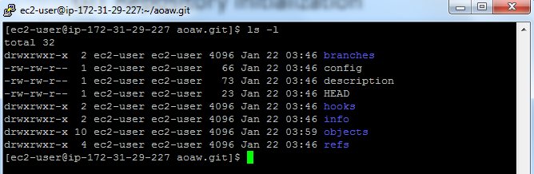
GIT Initialization - Remote

Slide 27
Tortoise GIT
Git-Client Installation

Slide 28
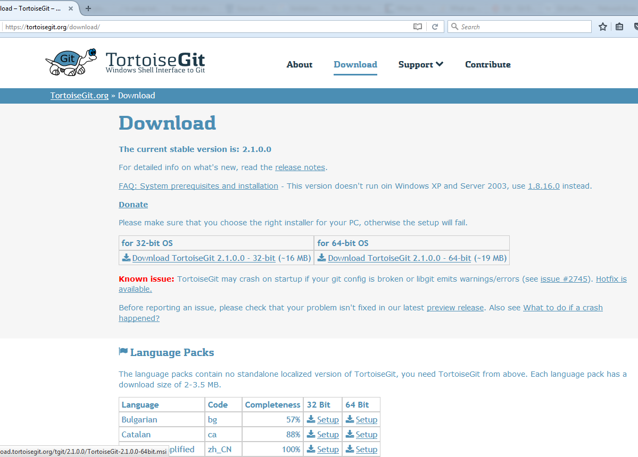
Tortoise GIT Installation

Slide 29
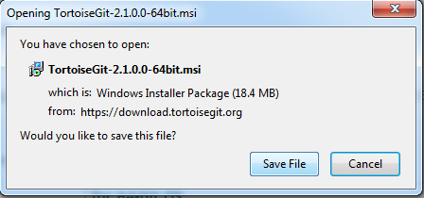

Slide 30
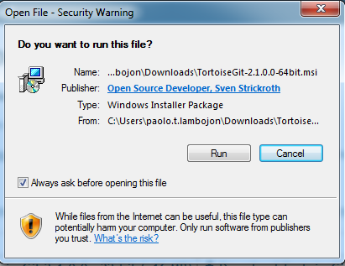

Slide 31
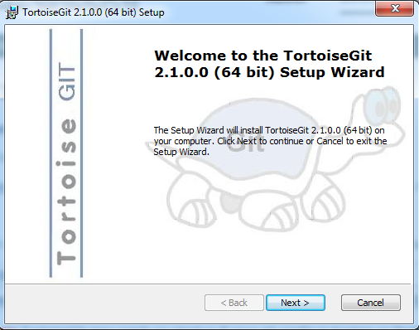

Slide 32
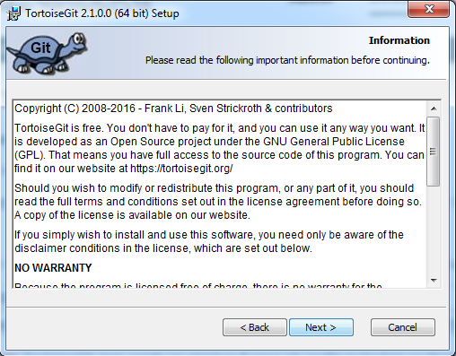

Slide 33
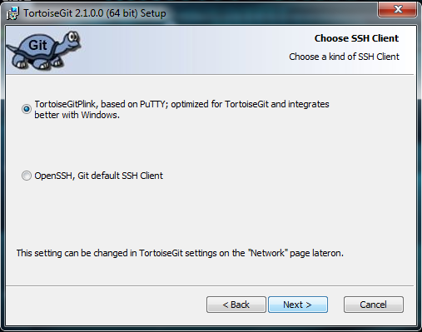

Slide 34
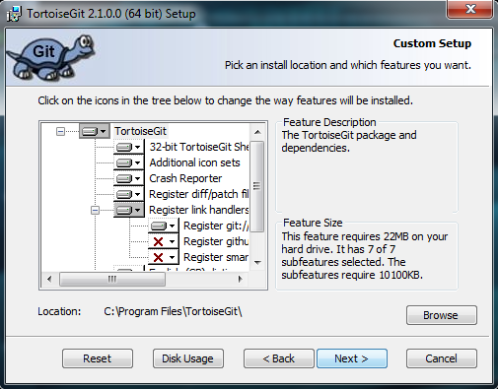

Slide 35
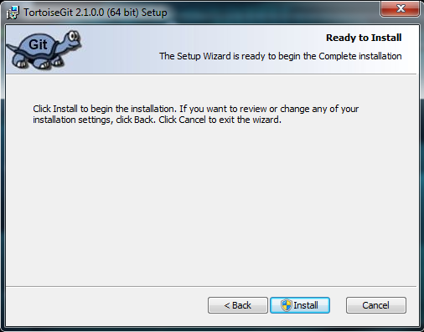

Slide 36
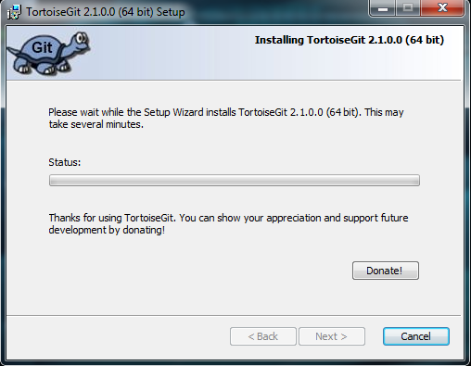

Slide 37
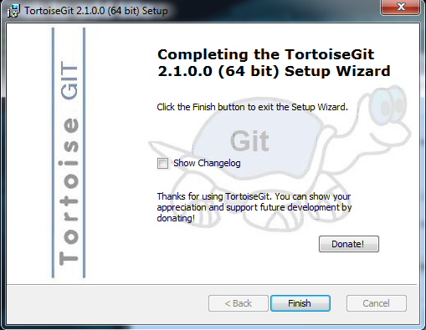

Slide 38
GIT Installation

Slide 39
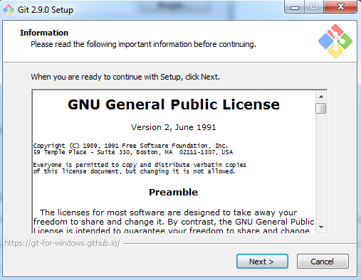

Slide 40
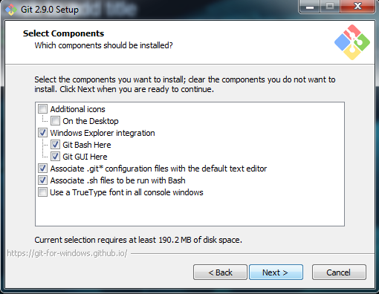

Slide 41
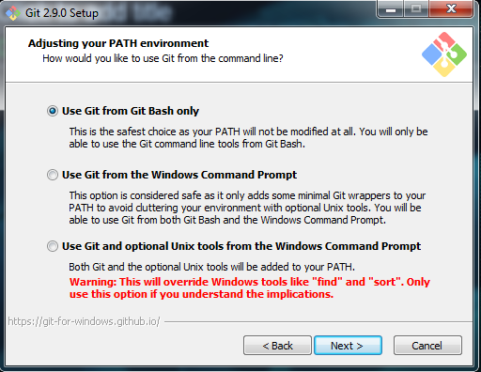

Slide 42
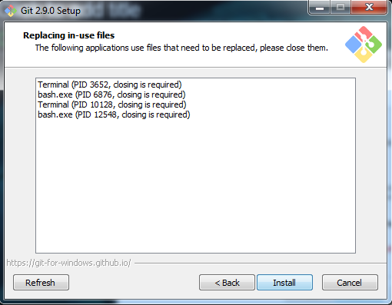

Slide 43
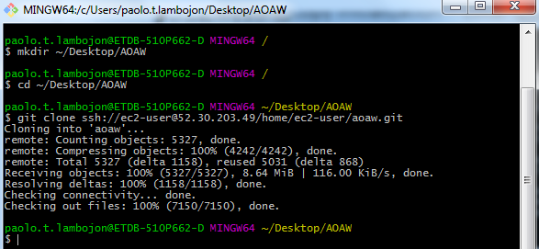
Remote Repository Cloning
Configure and Initialize Repository
git config –global user.email “email@example.com”
git config –global user.name “project devops 1010”

Slide 44
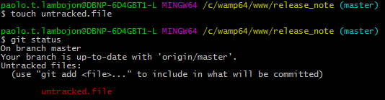
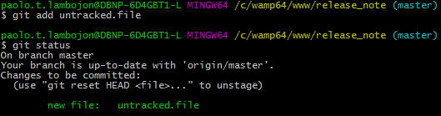
Tracked and Untracked Files
Untracked files in the working directory not in your last snapshot and are not in your staging area.
Tracked files are files that were in the last snapshot; they can be unmodified, modified, or staged.

Slide 45
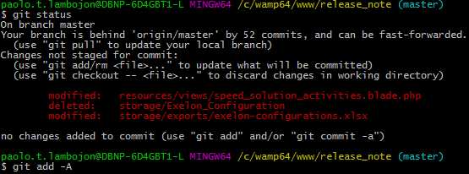
Check Local Repository Status
git status
git status <option>
Status Meaning:
' ' = unmodified
M = modified
A = added
D = deleted
R = renamed
C = copied
U = updated but unmerged ?? = untracked

Slide 46
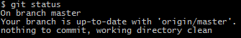

Migrate Files to Staged Area
git add <filename> or -A
git status
Notes:
“git add” is a multipurpose command used to
1) begin tracking new files
2) stage files
3) do other things like marking merge-conflicted files as resolved
Created and edit README file then run “git status”; it is untracked

Slide 47
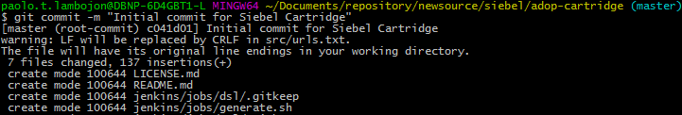
Publish Changes to Local Repository
git commit
git commit –m “Initial Commit”
Notes:
the commit records the snapshot you set up in your staging area;
recording a snapshot of your project you can revert to or compare to later;

Slide 48
Undoing Commit
git commit –amend
your snapshot will look exactly the same and all you’ll change is your commit message if there are no changes after the previous commit;
The same commit-message editor fires up, but it already contains the message of your previous commit. You can edit the message the same as always, but it overwrites your previous commit.
Notes:
When do you undo?
committed too early
forgot to add some files,
messed up your commit message

Slide 49
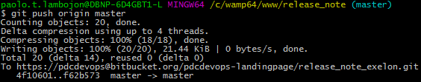
Push Changes to Remote Repository
git push
git push <remote> <branch>

Slide 50
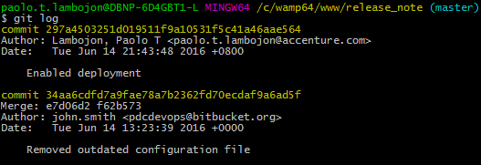
Viewing the Commit History
git log
git log <option>

Slide 51
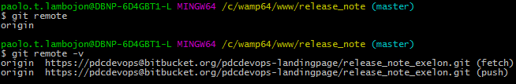
Viewing and Adding a Remote Repository
git remote
git remote –v
git remote add [name] [url]

Slide 52
Links
Accenture Bitbucket: https://newsource.accenture.com
GIT Installer: http://git-scm.com
Amazon Web Services: https://aws.amazon.com/console
Tortoise Git: https://tortoisegit.org

Slide 53
POCs
Coronado, Christian: christian.r.coronado@accenture.com
Serrano, Gigi: ma.a.d.serrano@accenture.com
Lambojon, Paolo: paolo.t.lambojon@accenture.com
DevOps Support: PDC.DevOps.Support@accenture.com

Slide 54
Demo

Slide 55
End

